Slide 1
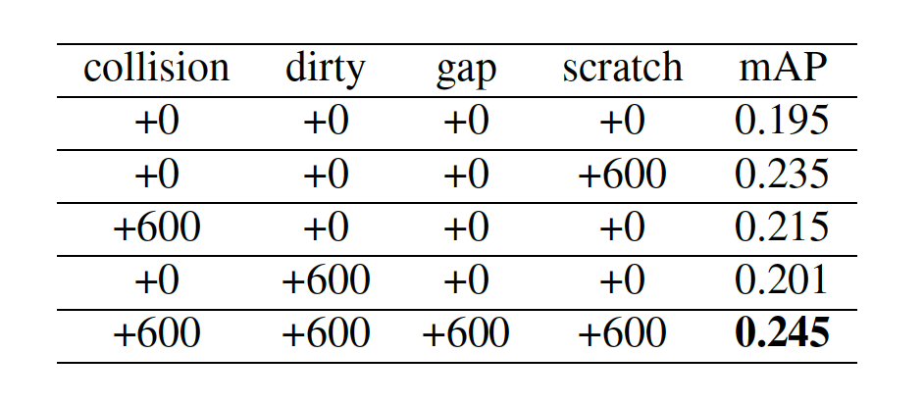
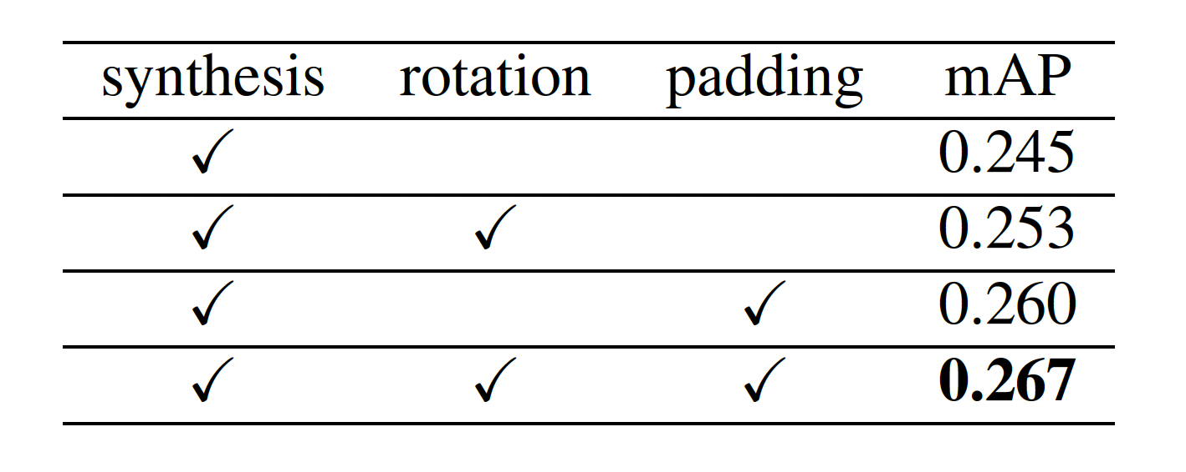
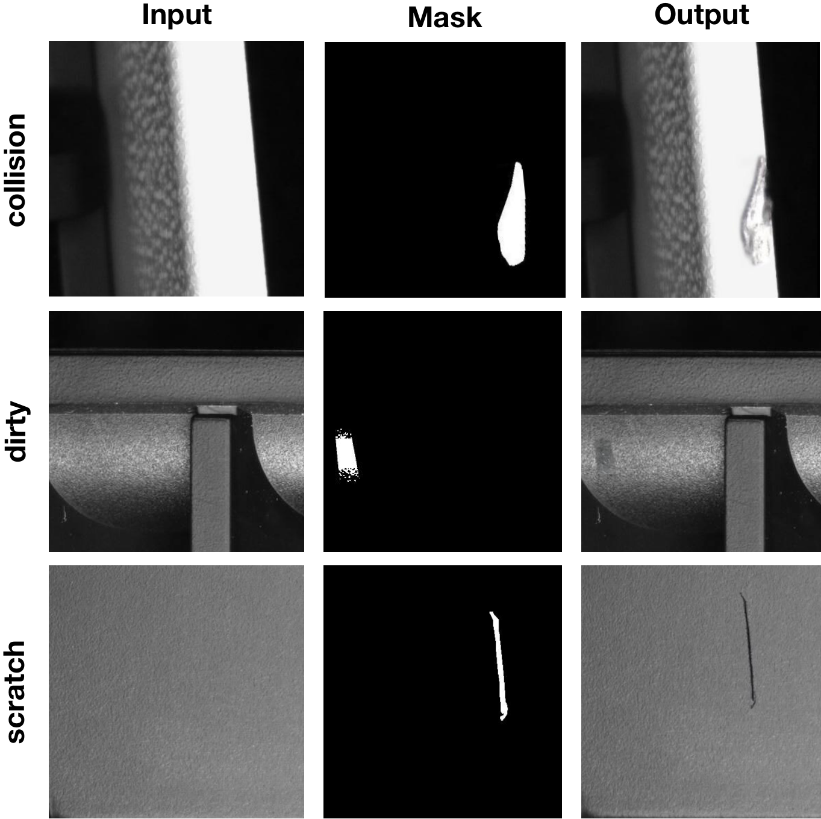
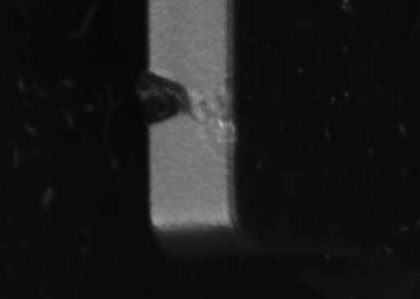
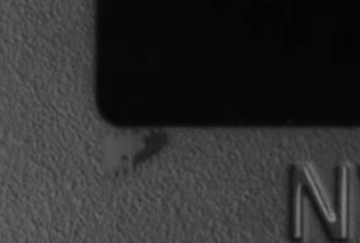
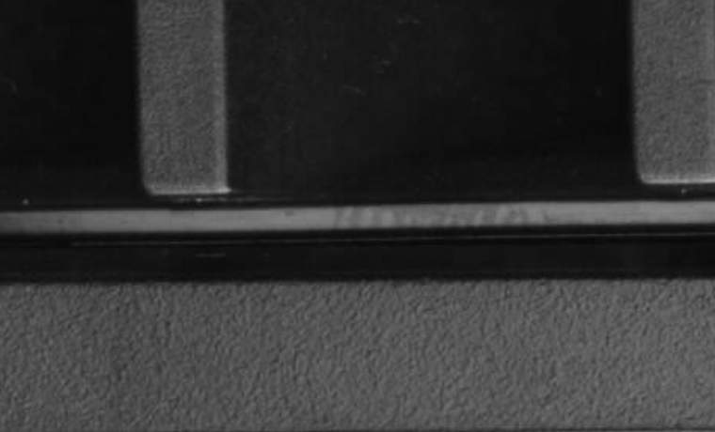
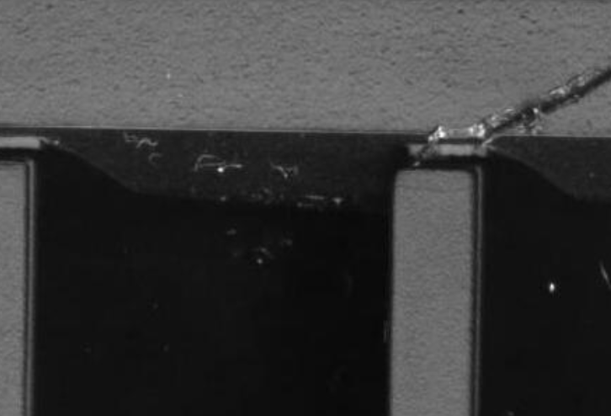
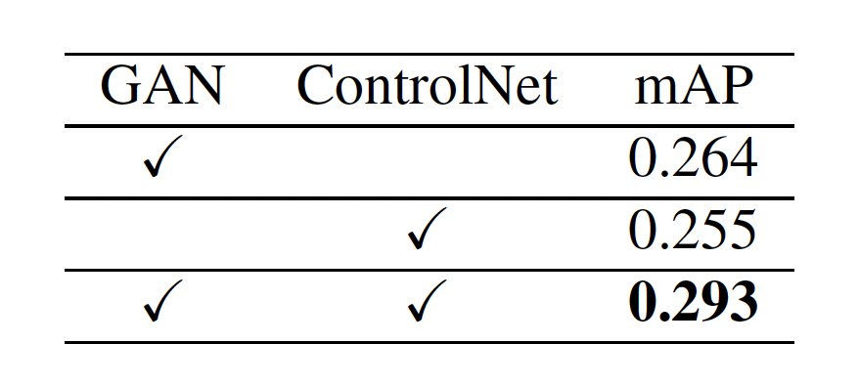
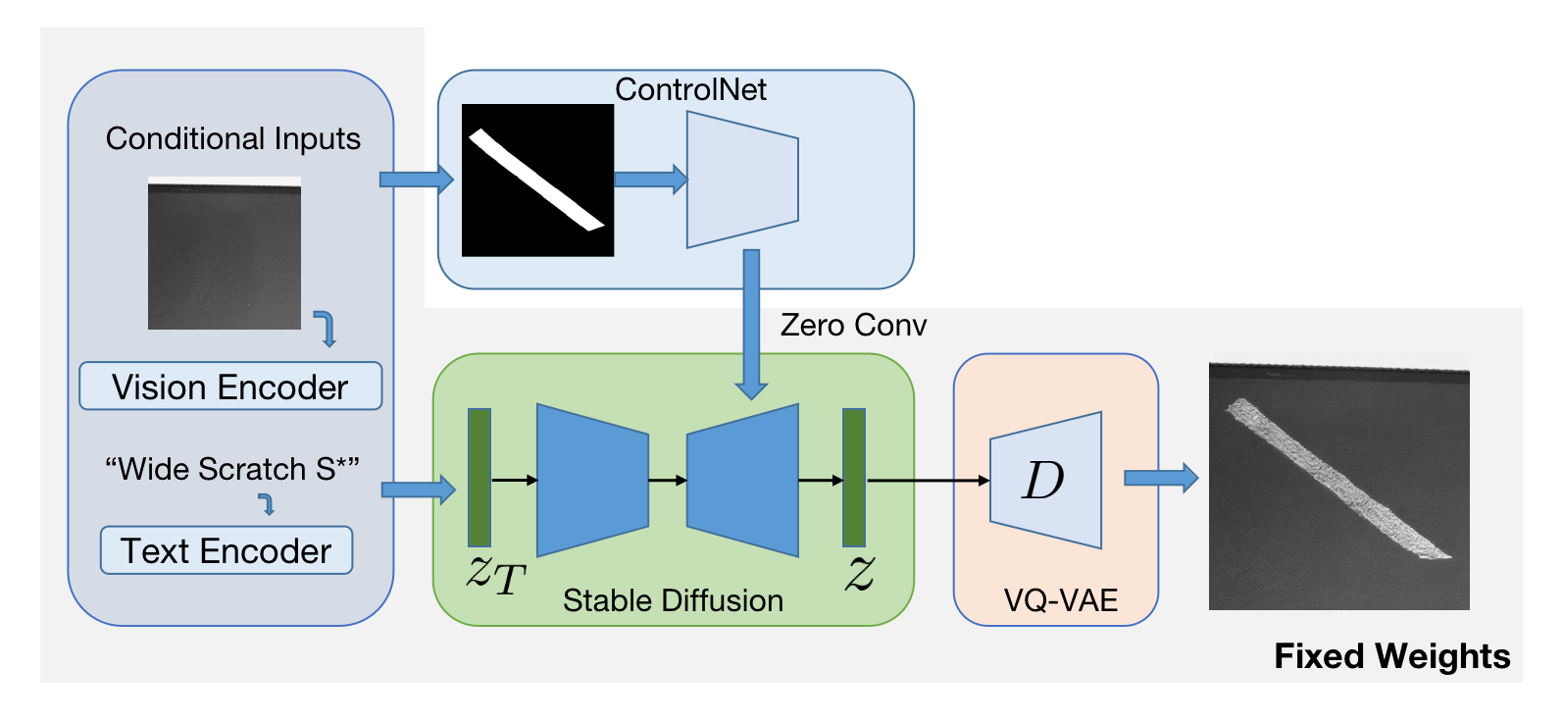
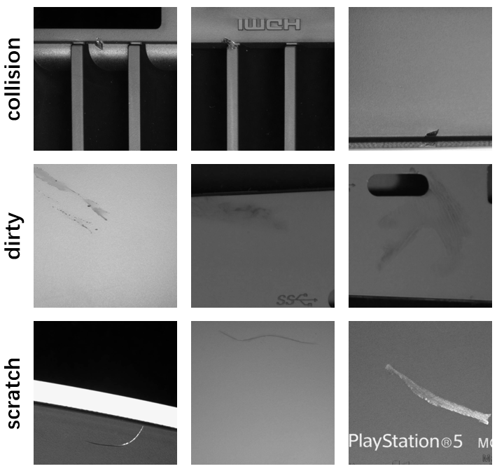
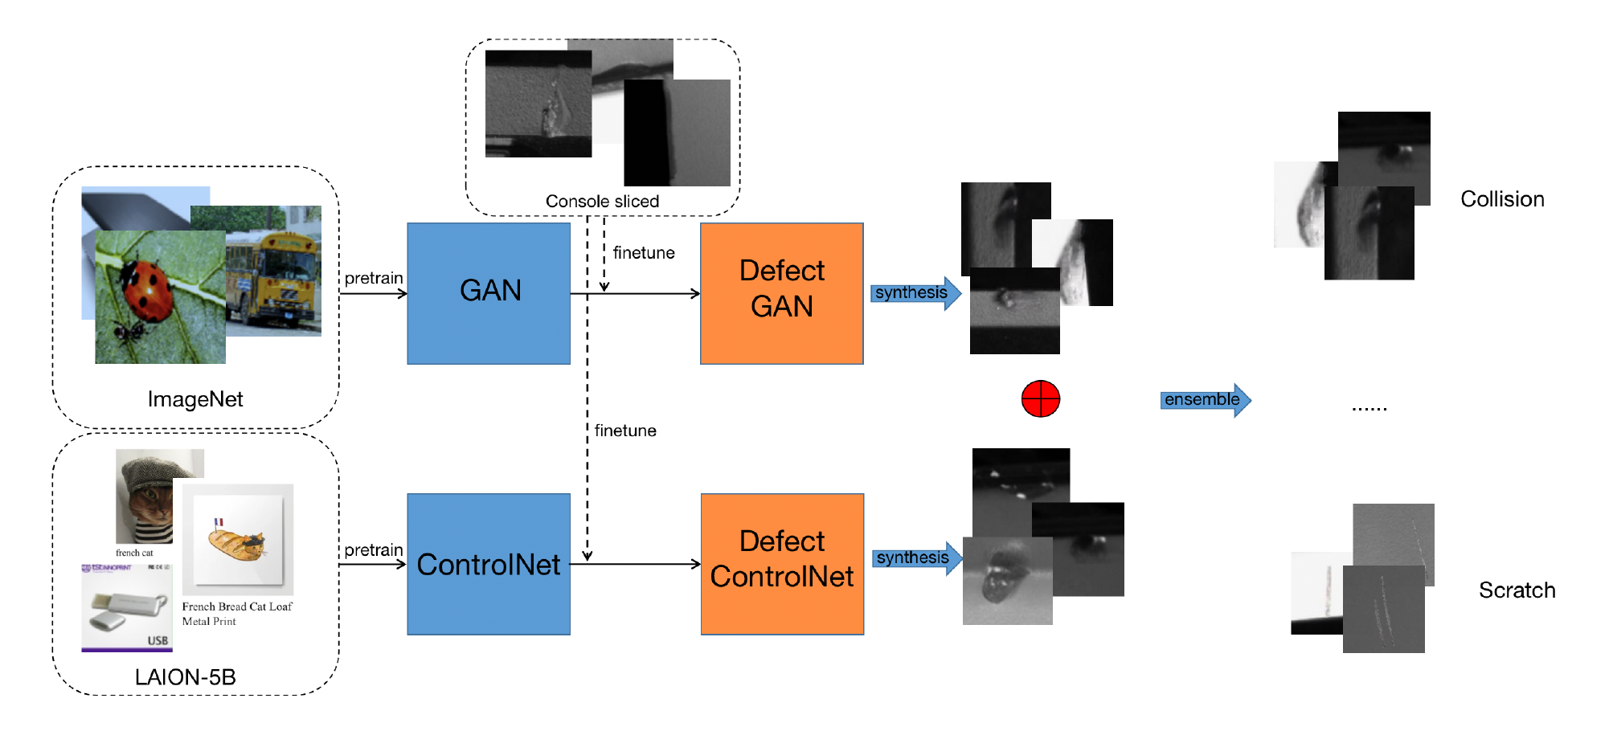
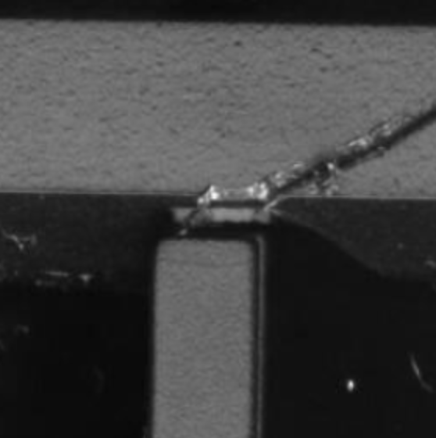
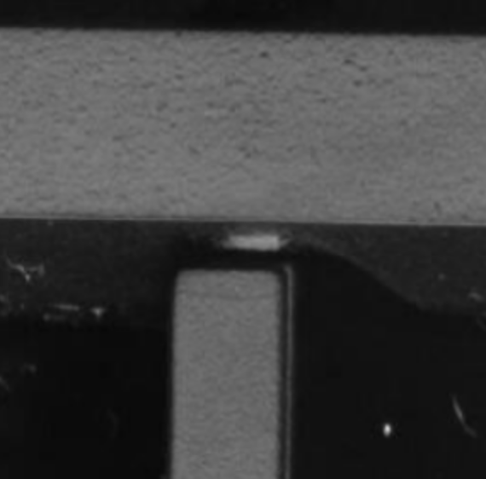
GAN and Diffusion Model Data Ensemble for Defect Generation at the 1st VISION Challenge
Zhaojie Tan*, Mingtao Guo*, Guanyu Xing, Zhenjiang Ni, Yanli Liu
Introduction
Ranked 1st at the 1st VISION Challenge track 2
Data ensemble with Defect GAN and Defect ControlNet
Dataset
Console sliced into 800x800 resolution
Training set: total 2226 and labeled 341 samples
Validation set: total 2256 and labeled 421 samples
Test set: total 7992 samples and no labels
Challenge
Limited labeled samples
Type, location, size controllable defect generation
Method
Defect GAN: High quality, Low diversity
Defect ControlNet: Low quality, High diversity
Combining the defects synthesized by both methods
Defect GAN
Appearance Net: color, texture and lighting features
Structure Net: structural features of background and defect
GAN Block: fusing appearance and structural features
Defect ControlNet
Base model: stable diffusion(SD) inpainting
Self-Supervised learning finetune
Texts and background as conditional inputs
Pre-processing
Generate background - defect image pairs
Ablation Study
Different categories of data synthesis comparison (left)
Image level rotation and padding comparison (right)
Results
Combining training and validation set
Combining Defect GAN and Defect ControlNet
Summary
Defect GAN based on StyleGANv2 is designed for defect data ensemble
Defect ControlNet based on SD inpainting is designed to synthesize defect data with masks and prompts
Both models are finetuned from a pre-trained model to avoid overfitting
The data synthesized by two different models are fused together, combined with image-level rotation, padding, cropping and resizing, achieved an mAP of 0.293 on the test set, and ranked 1st on the leaderboard
Collision: 52
Dirty: 43
Gap: 194
Scratch: 54
Inpainting

